Slide 1
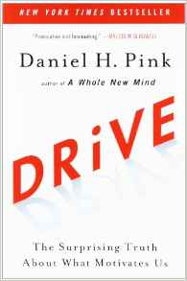
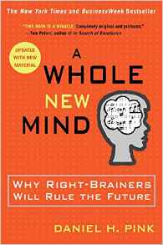
Intrinsic vs. Extrinsic Motivators

Slide 2
Forced Learning of Disassociated Concepts
Inhibits the Brain’s Natural Dopamine Production
Use of Extrinsic Motivators Messes with the Brain’s Natural, Intrinsic Reward System and Severely Limits Desired Outcomes. (Exception: Piecework)

Slide 3


Slide 4
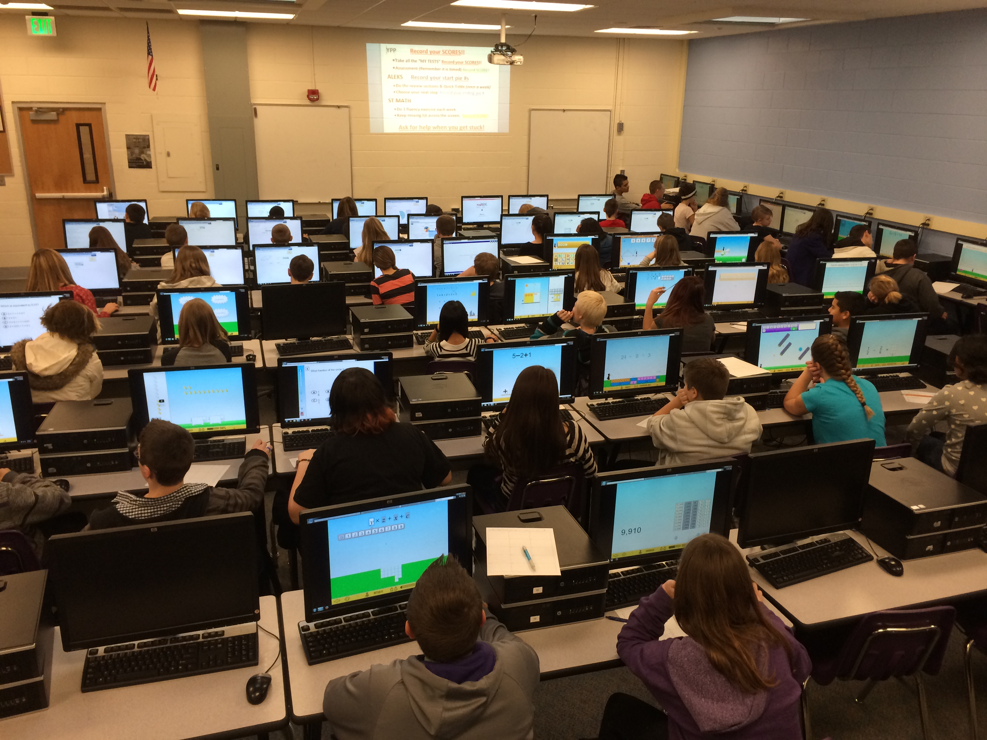

Slide 5


Man’s Search for Happiness

Slide 6
Man’s Search for Dopamine

Slide 7
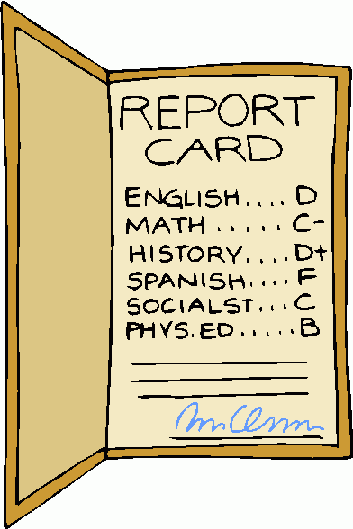

Slide 8

Carol Dweck researches “growth mindset” — the idea that we can grow our brain's capacity to learn and to solve problems. Are you not smart enough to solve it … or have you just not solved it yet?

Slide 9
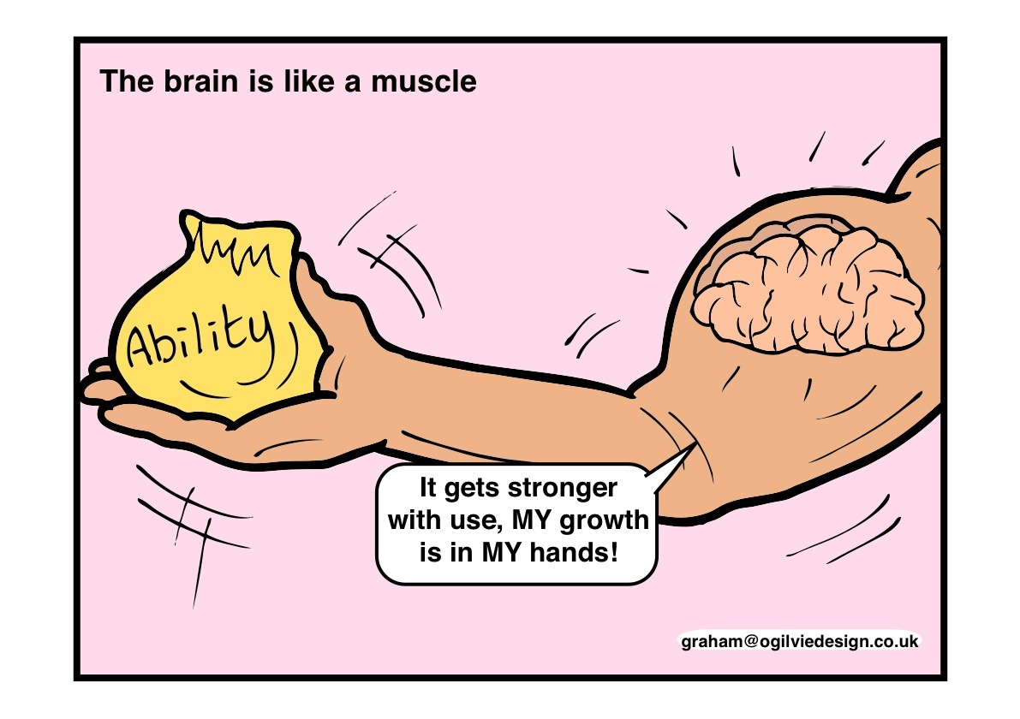

Slide 10
Historic Education: Learning Just In Case Today’s Education: Learning Just In Time - Through Digital Learning tools
Notes:
Historical vs Modern Education slide

Slide 11
Types of Education Technology
Online Courses
Virtual Classroom
Parent Communication Systems
Online Textbooks
School Connectivity
CAIS
Blended Learning
MOOCs
School Connectivity
Khan Academy
Virtual Schools
Student/Home Connectivity
Teacher Collaboration Tools
Computer Labs
Mobile Learning
Flipped Classrooms
Student Information Systems
Educational Apps
Gamification
Learning Management Systems
Bozeman Science
Online Wikis
One-to-One Devices
Educational Software

Slide 12
CAIS
Computer-Assisted Instructional Software which Delivers Immediate, Interactive, Adaptive Feedback
To Each Student Response

Slide 13

CAIS respects the learning style of each student and personalizes learning for every learner.

Slide 14

Skill building and content knowledge
through individualized adaptive instruction
Notes:
Generic computer class instead, clip of teachers, end with drooling

Slide 15


Slide 16
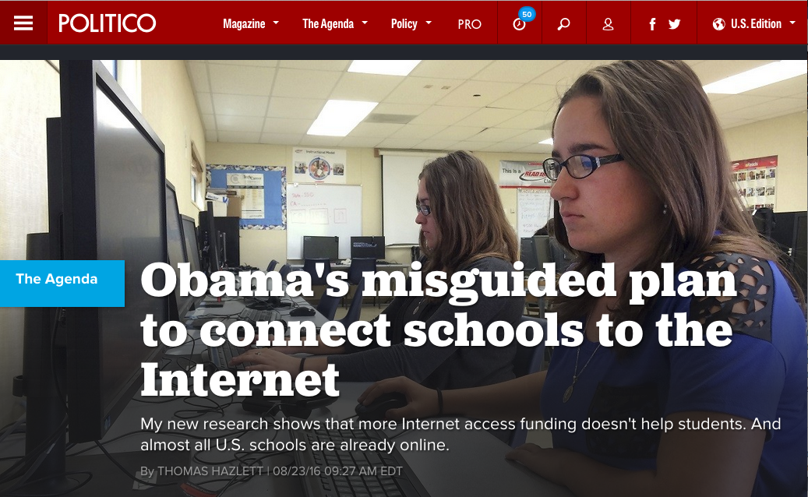

Slide 17

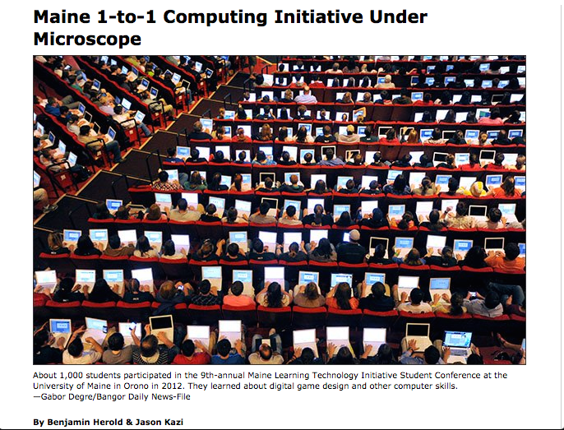

Slide 18
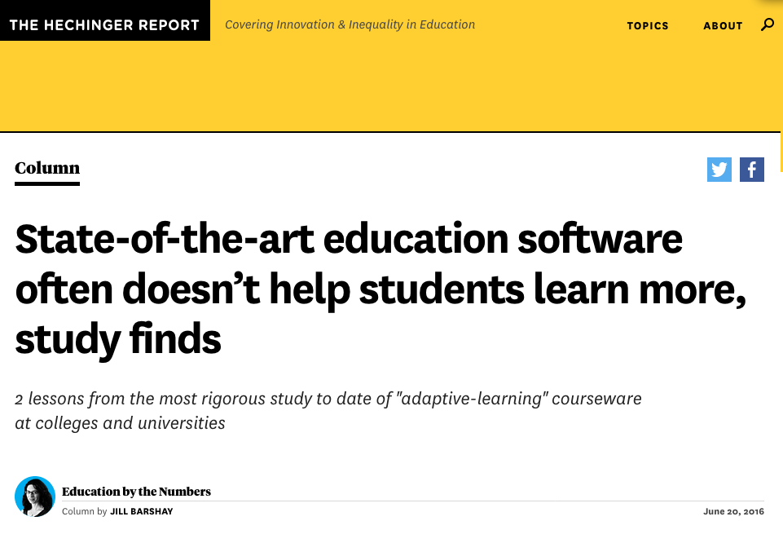

Slide 19
INFIDELITY
Lack of Focus/Vision
Insufficient Professional Development
Integration in the Instructional Model
Dose Rates – Frequency & Duration
Prescriptive Teacher Interventions
95% of Computer Assisted Instructional Software not used with fidelity

Slide 20
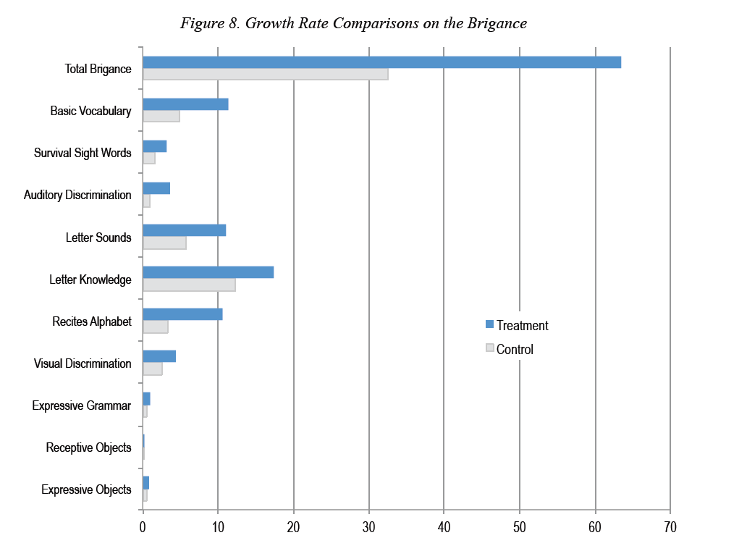

Slide 21
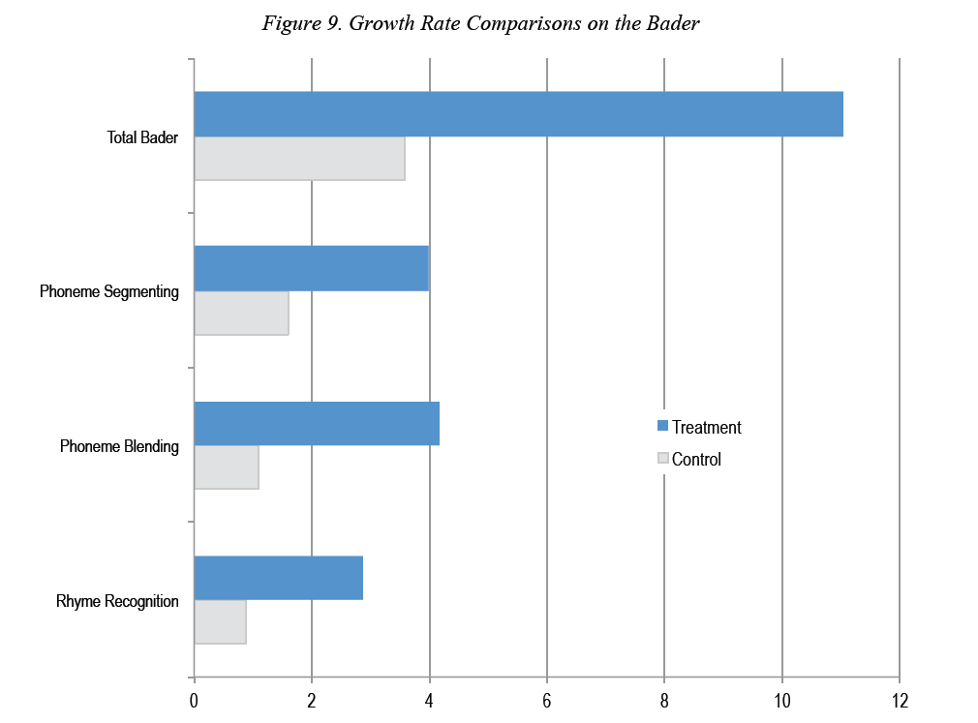

Slide 22
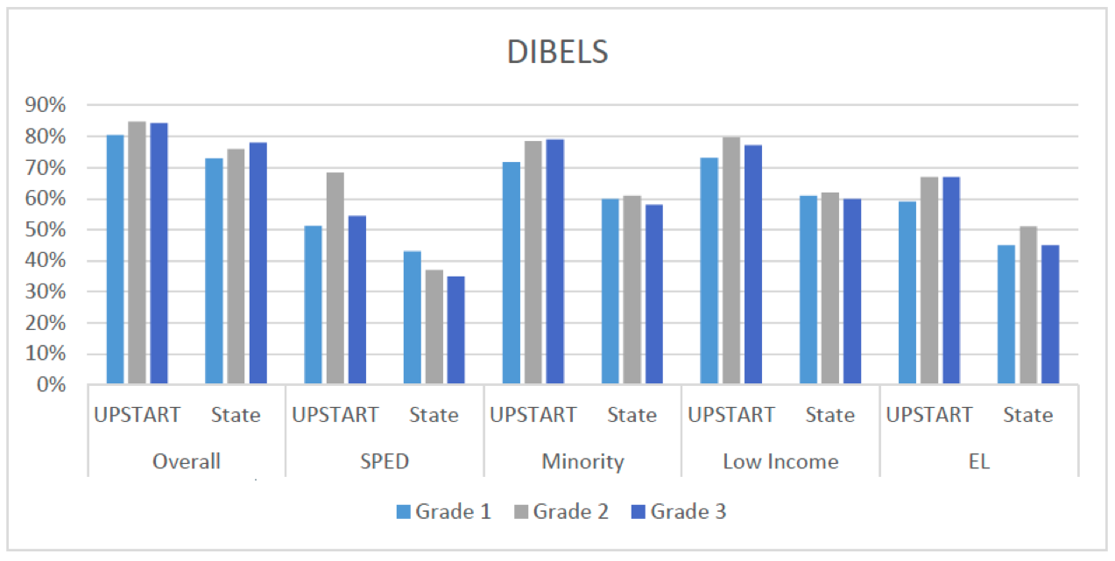
UPSTART Home-based Pre-K Longitudinal Effects on DIBELS Scores - Grades 1, 2 & 3

Slide 23
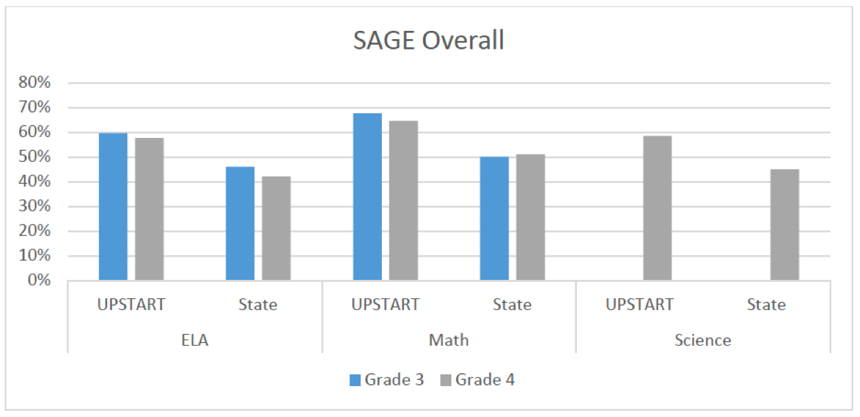
UPSTART Home-based Pre-K Longitudinal Effects on State Assessments - Grades 3 & 4

Slide 24
350,000 Utah Students Are Receiving Daily Personalized Learning
Pre-K
Early Intervention Reading
ELL English Language Acquisition
Elementary Math Software
Secondary Math Software

Slide 25
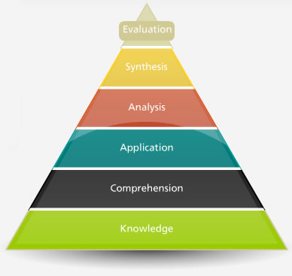
Bloom’s Taxonomy

Slide 26
Non-cognitive benefits of digital learning tools are as significant as cognitive benefits
Self confidence
Stigma of grouping students
Sense of well-being
Positive attitude towards school
Less absenteeism
Social and emotional growth

Slide 27


Slide 28
350,000 Utah Students Are Receiving Daily Personalized Learning
Home-Based Pre-K
Electronic DIBELS Assessment
Early Intervention Reading Software
ELL English Language Acquisition Software
Elementary Math Software
Secondary Math Software

Slide 29
Third Party Evaluations Show Effect Sizes of 1.07 and More When Software Licenses are Implemented with Fidelity.
When Implemented Poorly, Digital Tools Often REDUCE Student Performance
Too many Utah Reading and Math Software Licenses Were NOT Implemented with Fidelity

Slide 30
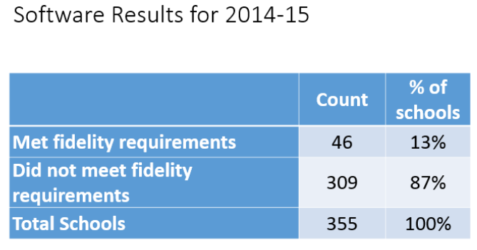

Slide 31

Story of the Starfish Thrower

Slide 32
Starfish allegory in education admits that millions will be left behind

Slide 33
Through Personalized Learning, we can re-immerse all students in an environment where they can thrive

Slide 34
Let’s Restore Students As Autonomous, Self Directed Learners through Personalized Learning which is Immediate, Interactive, and Adaptive

Slide 35
Mastery for All Students Through Personalized Learning
Senator Howard Stephenson
hstephenson@le.utah.gov
801 815-6800 (mobile)

